Slide 1

Lockheed Martin’s Cyber Kill Chain:An Overview
Presented by:-
Noel Varghese
3’rd Year UG student
CSDF branch @ VIT Bhopal

Slide 2
Table of Contents
Topic | Slides
Introduction to the Cyber Kill Chain | 3-4
Applications of the Kill Chain | 5
Stages of the Cyber Kill Chain | 6-15
Preventive Tactics for each Chain stage | 18-21
Protection against Data Exfiltration | 22
Recap | 23

Slide 3
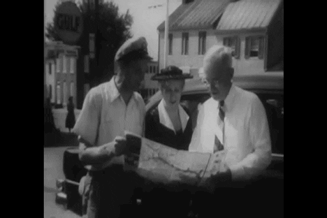
Ok,so what are we talking about here?
Imagine you are an architect and are tasked with building a house.How do you go about that?
A blueprint - akin to an algorithm,design or a set of instructions.It gives all the information a skilled person requires to perform some work.
We have a similar problem in the Cyber World,i.e how do threat actors orchestrate their attacks? .Is there any way to map that?
For that,Lockheed Martin,an American defense security organization came up with the defender’s blueprint - “Cyber Kill Chain”

Slide 4
Applications of the Kill Chain
October 17 2021 - Attempts to perform a distributed hacking attempt across Israel’s hospitals.
Defender of Attack -National Cyber Directorate,Israel
Stages of attack successfully performed - 6 Attack attempt thwarted at - Stage 7 (Exfiltration)
August 2018 - Attackers aimed to rig the US Voter Database,attempting to steal PII information and sell it on the dark web Defender of Attack - The Democratic National Committee
Stages of attack successfully performed - 4 Attack attempt thwarted at - Stage 5 (Installation)
We can compare the Kill Chain to India’s IT Act (2000).In a day,tens of cases are ruled or given verdict based on the established framework of the IT Act.This is how important the Kill Chain is to organizations,batting away computer attacks every day

Slide 5
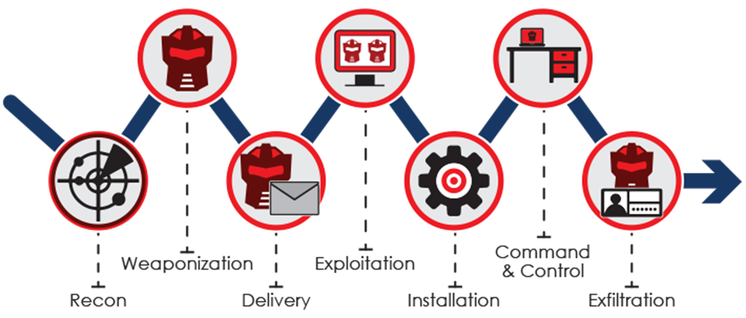
Cyber Kill Chain - a 7-step process
For that,Lockheed Martin,an American defense security organization came up with the defender’s blueprint - “Cyber Kill Chain”

Slide 6

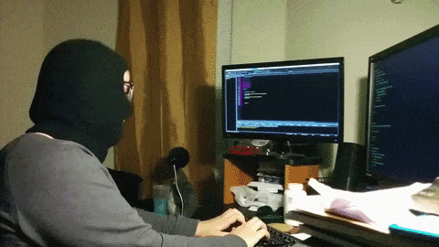
Step 1 - Reconnaissance
Your identity on the Internet is not private at all,unless you are not using the Internet or are living under a rock.
The World Wide Web is literally the hotbed for gathering your info.
Sources to collect your information:-
Google Dorking - also known as Google Hacking
Open Source Projects / Tools
Public Records - which is aided by Right to Information (citizens of India) - can be misused by attackers to scrape your data
Phishing Mails - Don’t fall for these!

Slide 7
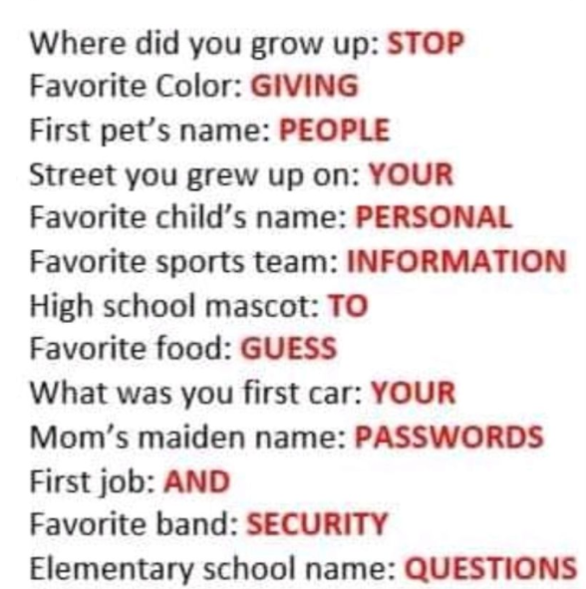
What aids attackers in performing easy reconnaissance?
Facebook posts like these ->
Sharing personal information
like travel plans and ID numbers
Lack of user awareness and Cyber
Hygiene
Social Engineering techniques:-
Consensus , Familiarity , Trust ,
Intimidation , Authority & Urgency

Slide 8

Reconnaissance using OSINT
Hot tools available on the Internet
PimEyes,Yandex & Google Image Search - (for reverse image search purposes)
Exiftool & Forensically (Gain metadata of an image or video)
Social Media OSINT
AnalyzeWords,Sleeping Time and SocialBearing.com (Tweets)
Snapmap - Find Snapchat users from locations around the world
Use your Right to Information,to dig through public records
With Rs 10/- and a signed request sheet,anyone can access Land,
Voter and other public records from Government Offices in India
OSINT is not illegal!

Slide 9
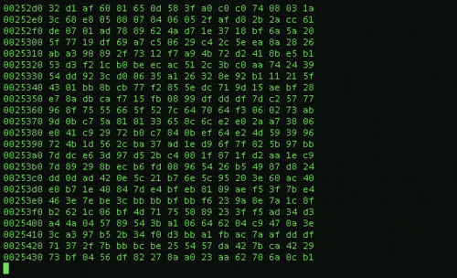
Second Step - Weaponization
What better way to inflict damage to potential victims,than having a few aces (tools) up your sleeve (armoury)?
Choice of weaponization include:-
Payloads - Inflicted by logic bomb
Steganography - Hide your payload inside something innocent looking
Custom Tools - Tailored to damage your victim’s systems or network architecture
Hardware - May include spyware like keyloggers,
rubber duckies or OMG Cables

Slide 10
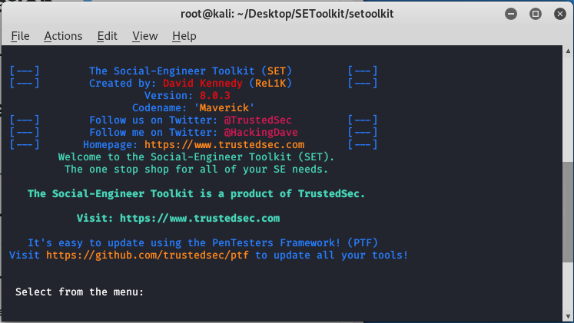
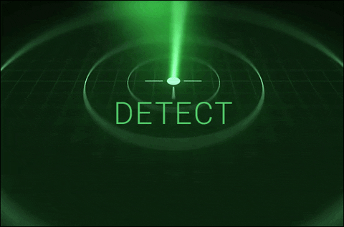
What factors go into weaponization?
Non-detection of antivirus , IDS or IPS - They should not detect your weapon
Tailored to attack OS’ and related components (This information is gained during reconnaissance)
Should be innocent looking to the average onlooker.Steganography and clever disguising methods help.
Should not raise suspicion to inner organizational security controls

Slide 11
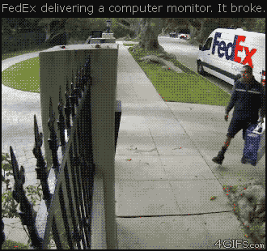
Third Step - Delivery
As the title suggests,this step involves bringing the weapon,to the target victim’s surroundings
Disguise it as a delivery order
How can you achieve this?
Get an internal member of the target organization to help youInternal Threat - Most significant risk to an organization
Should not be detected and raise red flags at all
This is a bad example.Attackers never do this!! ->

Slide 12

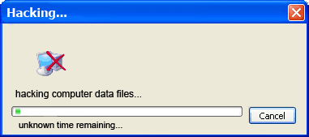
Fourth Step - Installation
Now that the weapon/tool is safely in the target’s surroundings (physical area),it’s time to install it in the target system/network architecture
Using a USB or flash drive - Physical installation of malicious software
Download it as an attachment,from email - phishing method (vulnerable users)
Internal Threat - Use the insider to install the tool
What helps in this step?
Credential Harvesting (Pharming)
Misconfigured Systems,Unauthorized access to computing resources

Slide 13

Fifth Step - Exploitation
This is where the first signs of attack emerge
It relies on:-
Victim clicking on malicious software
Logic Bomb (tool executes,when a certain condition is met)
Attacker initiating the attack,once installation step is successful completed
What points can an attacker exploit?
Vulnerable services existing on open ports - FTP,Telnet,SMTP
Default Configurations - Laptop Password set to “password” , Security Cameras ,which are IoT devices are also vulnerable,to default credentials as well
Unpatched Systems,having outdated OS updates and drivers
“An attacker only requires a single point of entry,to exploit and wreak havoc”

Slide 14
Sixth Step - Command and Control
A Command and Control server is established by the attacker,to elicit control over the remotely exploited device
Also known as C2 Server
This term is used in DDOS & Zombie attacks
What can be used by an attacker to create a C2 server?
Bots - They use the server to send and receive malicious payloads for exploitation,in advanced attacks
A backdoor - An undocumented entry point,for entry and exit.TO MAINTAIN PERSISTANCE

Slide 15
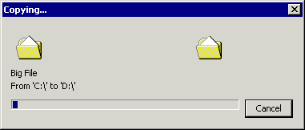
Final Step - Exfiltration
Being the seventh and the final step in the Kill Chain,it can sometimes be a miracle for attackers to penetrate this deep and security measures yet yet detecting the threat yet
What data can possibly be exfiltrated?
PII
Organizational secrets - Trade secrets
Intellectual Property - Research work

Slide 16
Remediation and Mitigation from each step of the Chain

Slide 17
Mitigation methods for each stage-How can you possibly prevent being exploited?
Performing a recap of what we have discussed up to now,what are the 7 stages of the Cyber Kill Chain?
PUT YOUR THINKING CAPS ON
It is widely disputed that ‘endpoint users’ are the most vulnerable and prone to mistakes,when implementing security measures
When thinking about it,does that notion make any sense?
Is the user misinformed about common attack vectors and threats,or are attacks successful due to the success rate and intelligence of the threat actor?

Slide 18
Prevention Techniques
Stage 1 - Reconnaissance - The usual ones
Do not post your personal info on social media.Blur out unnecessary or sensitive information
Keep your plans to yourself.There is no need for the whole world to know about it.
If you are concerned about privacy,reduce/limit your digital footprint
Delete accounts on websites that you no longer use.They could have been compromised in a breach
The InfoSec community’s go-to–go resource - HaveIbeenpwned (https://haveibeenpwned.com/)

Slide 19
Prevention Techniques - Stages 2 and 3
Stage 2 - Weaponization
SPOILER ALERT:Nothing much you can do here,if you have already been fixed as a target
Undertake asset management of your inventory - determine what are at risk how much of a threat do they pose
Patch those devices.Now!
Stage 3 - Delivery
Ask questions to suspicious looking people,loitering around your workplace
Do not authorize deliveries you never made
Undertake a through check on delivery men that come in to your workplace.Have them pass through an Access Control Vestibule and have them carry authorized Identity Cards
Physical Controls - Security Guards,Bollards,Gates and Fences

Slide 20
Prevention Techniques - Stages 4 and 5
Stage 4 - Installation
Ask questions to suspicious looking people,loitering around your workspace
Have a DLP solution configured on your workstation
Disable ports,for USB Injection (it’s possible)
Never download attachments from emails you don't trust
Have email filters in place
Installation of SIEM’s and IPS
Stage 5 - Exploitation
Patch those devices.Now!
Implement ‘Change Management’.Sandbox those updates and test them if they are in fact vulnerable.If found risk-free,deploy them to other hosts on the network
Use a SCCM,to manage centralized deployment of updates across hosts

Slide 21
Prevention Techniques and Exploitability
Stage 5 - Exploitation (continued)
Ensure that you buy legitimate hardware and software - these include routers,switches,legal software etc.It can be vulnerable to ‘Supply Chain Attack’
Installation of SIEM’s and IPS
If you are exploited in the worst case scenario,what do you need in handy?
A well trained IR team
Call Escalation Lists (Reporting)
Documentation of attack
Mitigation and Remediation
Compliance/rule requirements,to be followed during investigation

Slide 22
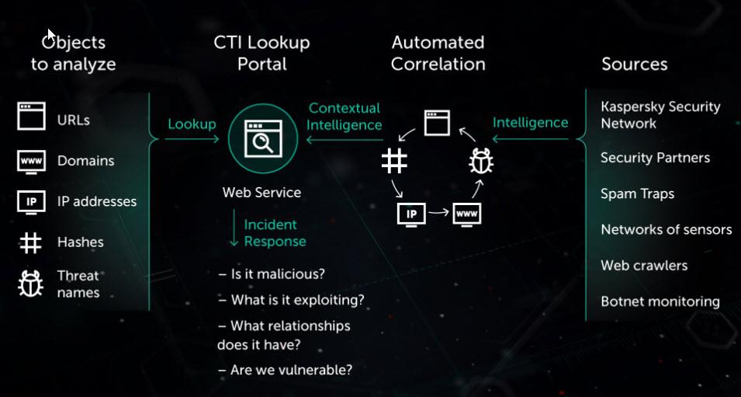
Tools that can help you
Maltego (OSINT and object mapping)
Threat Crowd, VirusTotal & Hybrid-Analysis (Virus Hash and Malware tracing)
Project Hades (Lookups of IP Addresses,SSH Keys & CSAM sites)

Slide 23
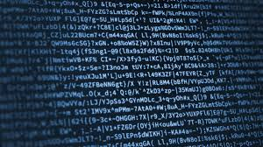
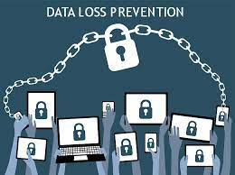
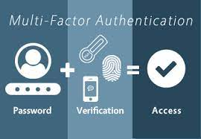
How can secure yourself from Data Exfiltration?
Some methods are:-
Encryption - using the strongest algorithms are advised
Security controls on the database repositories - coupled with KBA and MFA
Having least privilege policies in place - an unauthorized person should get null privileges
DLP Configuration - across hardware and software in the organization

Slide 24

What have we covered?
The Cyber Kill Chain
Use cases of the Kill Chain in real world and its application
Lack of training or user ignorance?
Prevention techniques to avoid an attack instance
What do you need to do,if exploited?

Slide 25

Doubts and Queries

Slide 26

Connect with me on LinkedIn - https://www.linkedin.com/in/noel--varghese/
I always look forward to discuss cybersecurity,with peeps and would love to join your network

